Slide 1
Remote monitoring의 활용 : PM, ICD, CRT
KSHNE 2022
Daehoon Kim, MD
Assistant Professor,
Division of Cardiology, Severance Cardiovascular Hospital,
Yonsei University College of Medicine, Seoul, Korea

Slide 2
Agenda
Evidence about remote monitoring
Recommendations from current guidelines
Current status of remote monitoring use
Three cases

Slide 3
Evidence about Remote monitoring
Survival benefit ?
Reduction of frequency of in-office visit
Reduction of inappropriate shocks
Economic effect
Arrhythmia detection
Prediction of the risk for HF hospitalization
How to perform trans-septal puncture
Complications & difficult cases

Slide 4
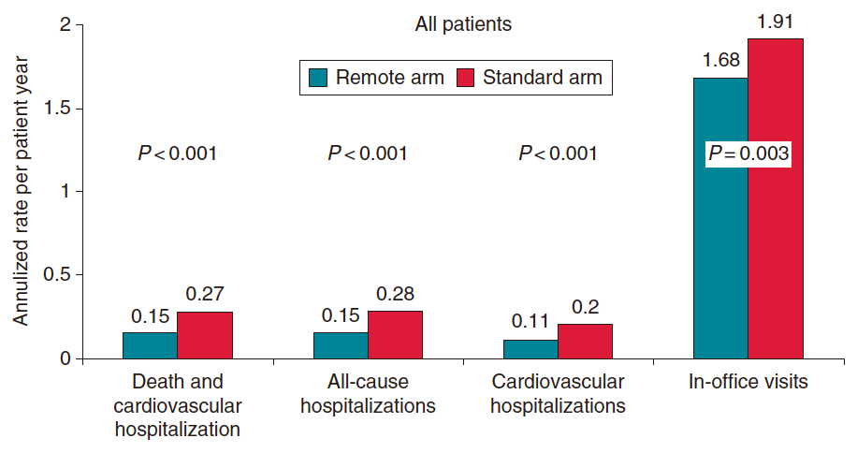
Evidence about Remote monitoring
1. Survival benefit ??
EFFECT study: a multi-centre trial from Europe
enrolling 987 ICD/CRT-D patients
Reduced death and CV hospitalizations in remote arm, but non-randomized!!!
(“healthy-user effect”)
De Simone, et al. Europace (2015) 17, 1267–1275

Slide 5
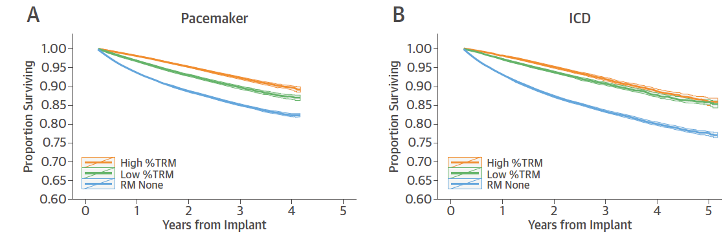
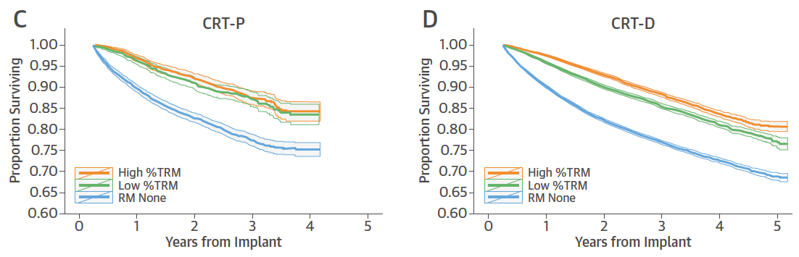
Evidence about Remote monitoring
1. Survival benefit ??
A retrospective data using the U.S. St. Jude market registry
enrolling 269,471 PM/ICD/CRT patients
Adherence to RM → Improved survival irrespectively of CIED type
Varma, et al. J Am Coll Cardiol (2015) 65, 2601–2610

Slide 6
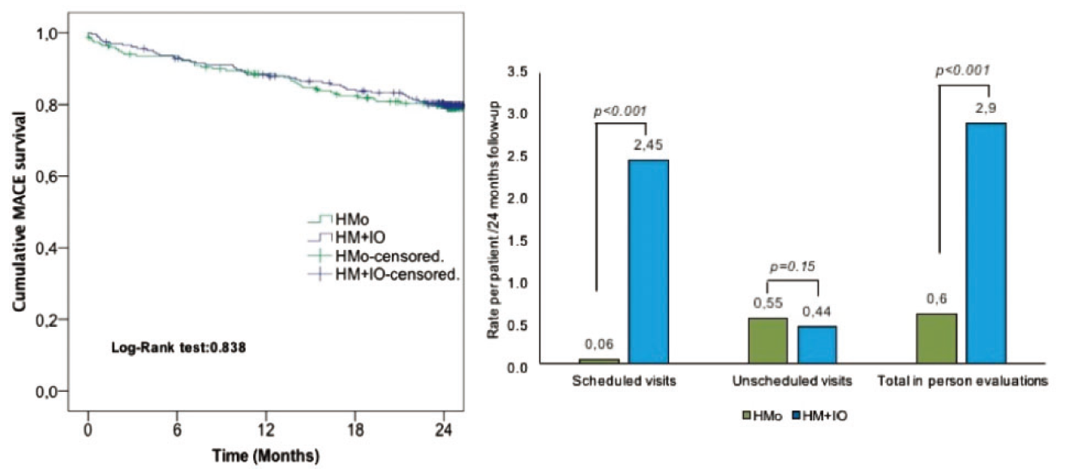
Evidence about Remote monitoring
2. Reduction of frequency of in-office visit
RM-ALONE trial enrolling 294 PMs and 151 ICDs
including patients PM-dependent and 2ndary prevention
Remote interrogation + RM vs. In-office interrogation (every 6 months) + RM
: non-inferior in MACE risk and reduced hospital visits and staff workload.
(Death + Stroke + Hospitalization due to cardiac cause or device + Device-related surgical intervention)
Garcia-Fernandez et al. European Heart Journal (2019) 40, 1837–1846

Slide 7
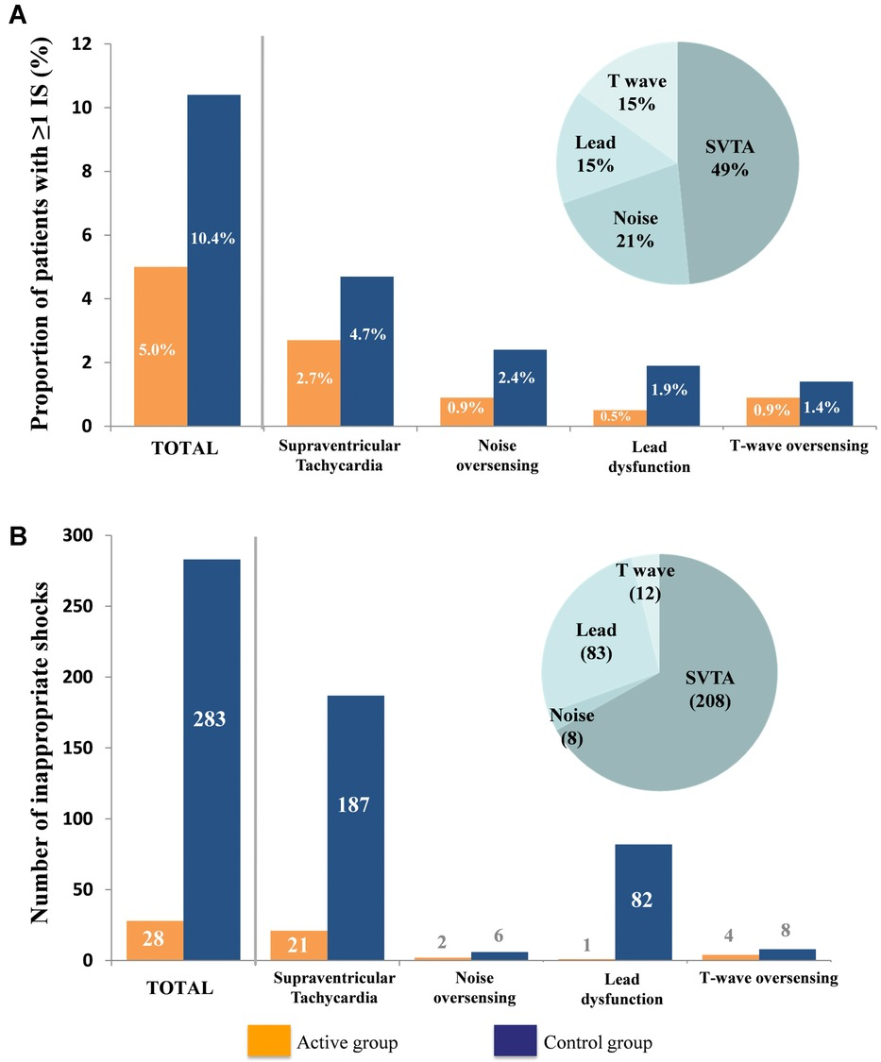
Evidence about Remote monitoring
3. Reduction of inappropriate shock
ECOST trial enrolling 433 ICDs
RM (once a year visit) vs. ambulatory (every 6 months visit)
Over a follow-up of 27 months,
≥1 inappropriate shock happened in
5.0% of patients in the RM group
vs. 10.4% in the ambulatory group (P = 0.03)
In particular, the vigorous treatment of SVT and
meticulous programming of the devices
Gu´edon-Moreau et al. JCE 2014;25:763-770

Slide 8
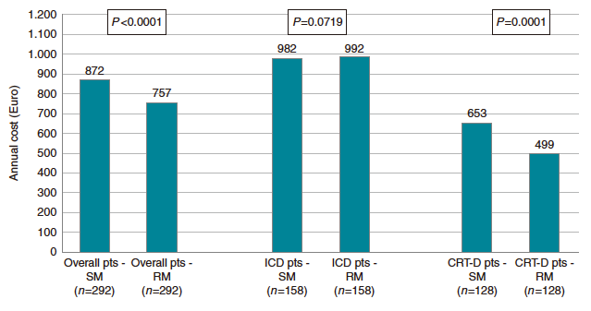
Evidence about Remote monitoring
4. Economic effect
Economic evaluation of the results of EFFECT : a multi-centre trial from Europe
RM produces lower costs for the healthcare service in a real-world cohort of HF, especially with CRT-D
Capucci, et al. Europace (2017) 19, 1493–1499

Slide 9
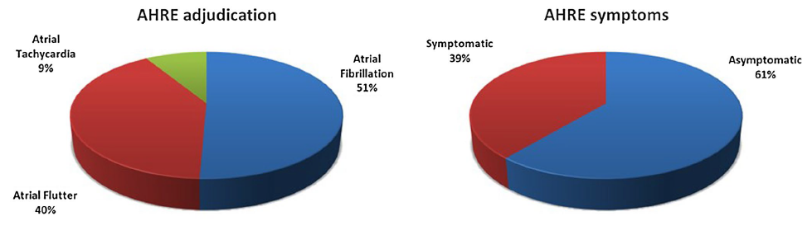
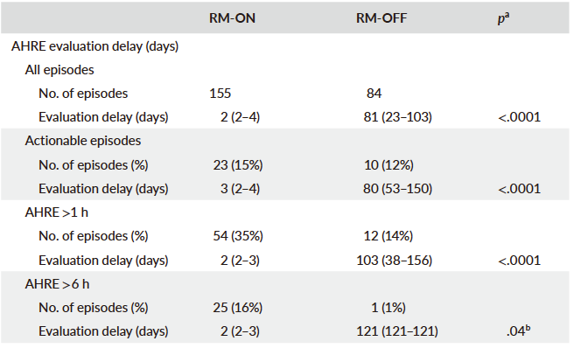
Evidence about Remote monitoring
5. Arrhythmia detection
RM (RM-ON group; N = 64) : 1 and 18 months in-office visits
vs. Conventional in-office visits (RM-OFF group; N = 33) : 1, 6, 12, and 18 months in-office visits
79 days
of delay
Russo, et al. Journal of Arrhythmia. 2022;38:213–220.

Slide 10
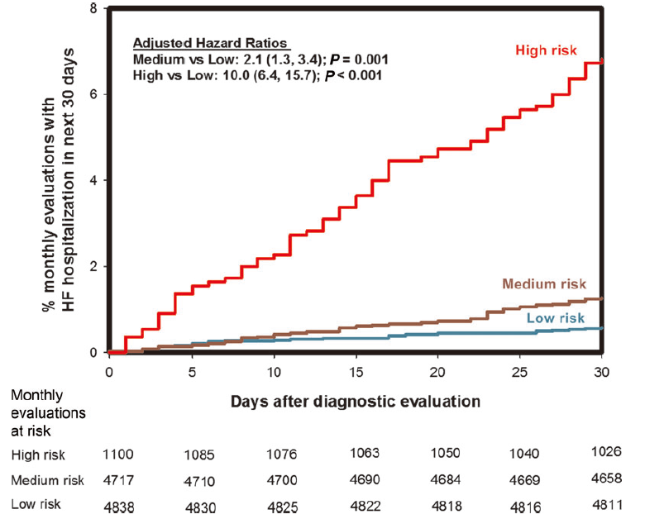
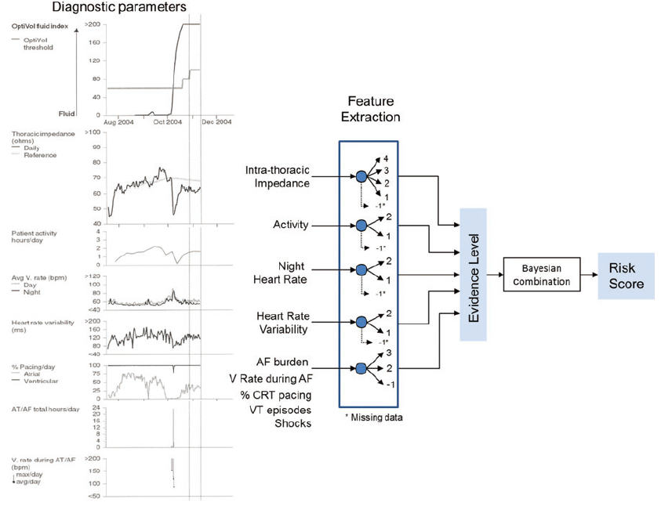
Evidence about Remote monitoring
6. Prediction of the risk for HF hospitalization
TRIAGEHF from Medtronic ICDs
The risk status reported for the patient for the next 30 days is based on
the maximum daily risk status for the previous 30 days.
Cowie, et al. European Heart Journal (2013) 34, 2472–248

Slide 11
Evidence about Remote monitoring
Survival benefit ?
Reduction of frequency of in-office visit
Reduction of inappropriate shocks
Economic effect
Arrhythmia detection
Prediction of the risk for HF hospitalization
No RCT evidence, but adherence to RM → improved care level
Up to 24 months of interval is safe
53% reduction in inappropriate shocks
Reduction in health-care costs
79 days of earlier detection
High risk group : x10 HFH risk
Low risk group : 94% of NPV

Slide 12
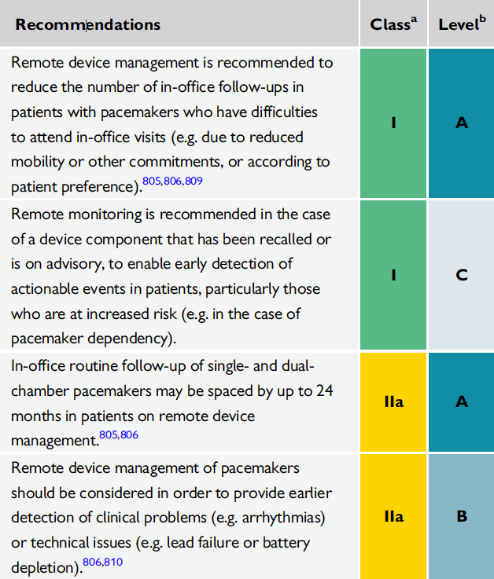

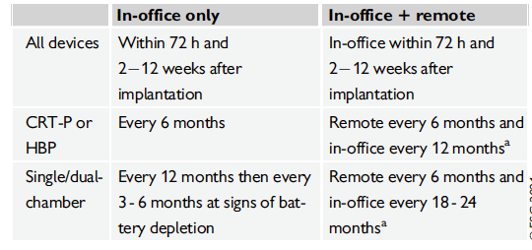
Recommendations from current guidelines
PM
ICD
2021 ESC Guidelines on cardiac pacing and cardiac resynchronization therapy
2022 ESC Guidelines for the management of patients with ventricular arrhythmias and the prevention of sudden cardiac death

Slide 13
Current status of remote monitoring in US
COVID-19 Pandemic
Figures in courtesy of Rohit Mehta

Slide 14
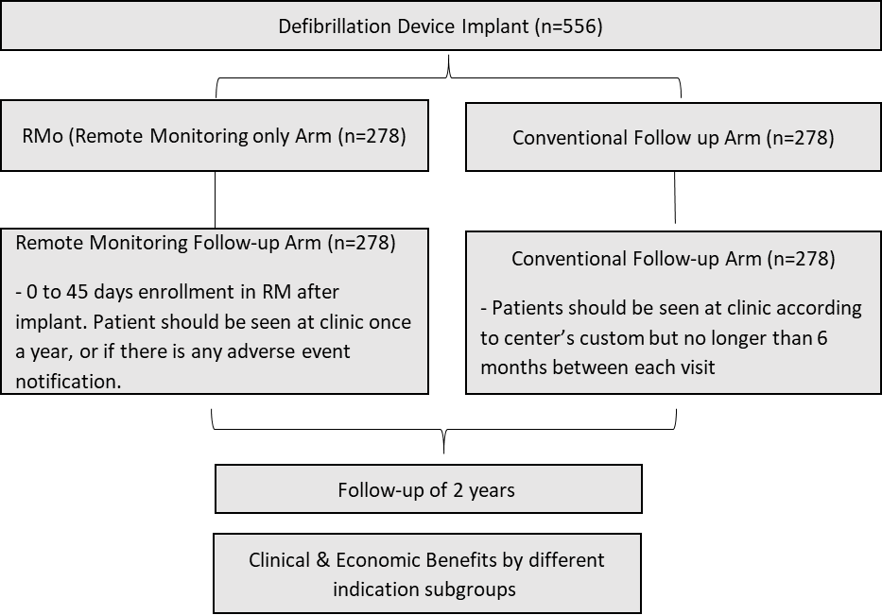
Current status of remote monitoring in Korea
Economic and Clinical Benefit of Remote Monitoring among Defibrillator Patients by Indication Subgroups (BENEFIT-RM) trial
: enrolled 337 patients starting from 2020
Remote interrogation
every 6 months
+ In-office 6 months
In-office
every 3 months

Slide 15
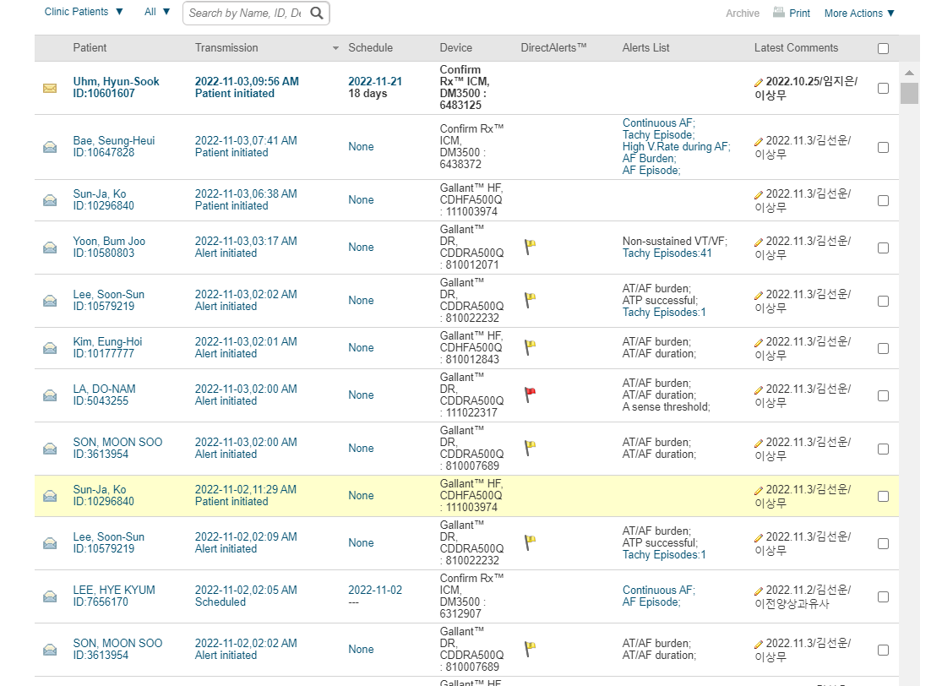
Merlin.net
Cases
  Gallant ICD & CRTD
  Confirm Rx ILR
  위의 Device들은 환자의 스마트폰과 페어링하여 Daily Alert 및 Patient Initiated Alert 등을 Merlin.net Remote Monitoring System으로 전송

Slide 16
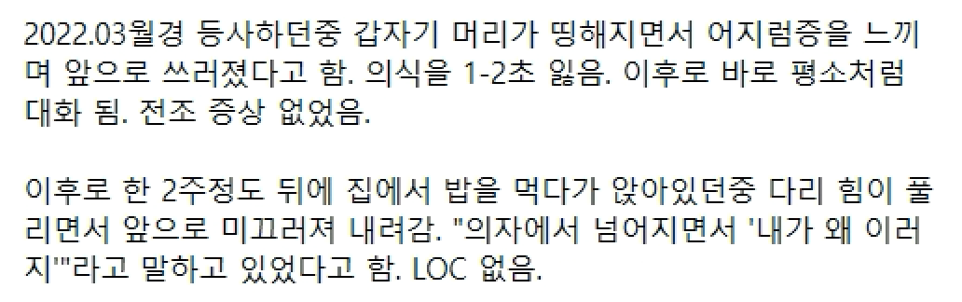
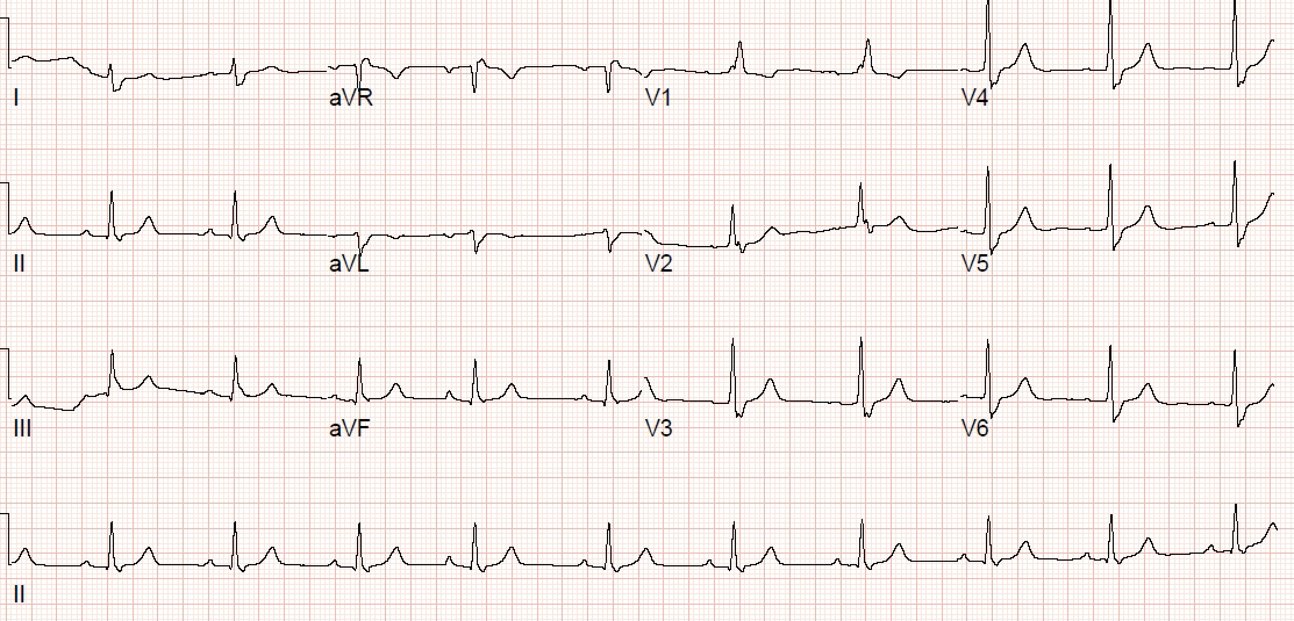
h
Case 1 (M/57)
Case 1 (M/57)
Referred to EP for evaluation of syncope
HUT : negative
TTE
- EF 62%
- no RWMA

Slide 17
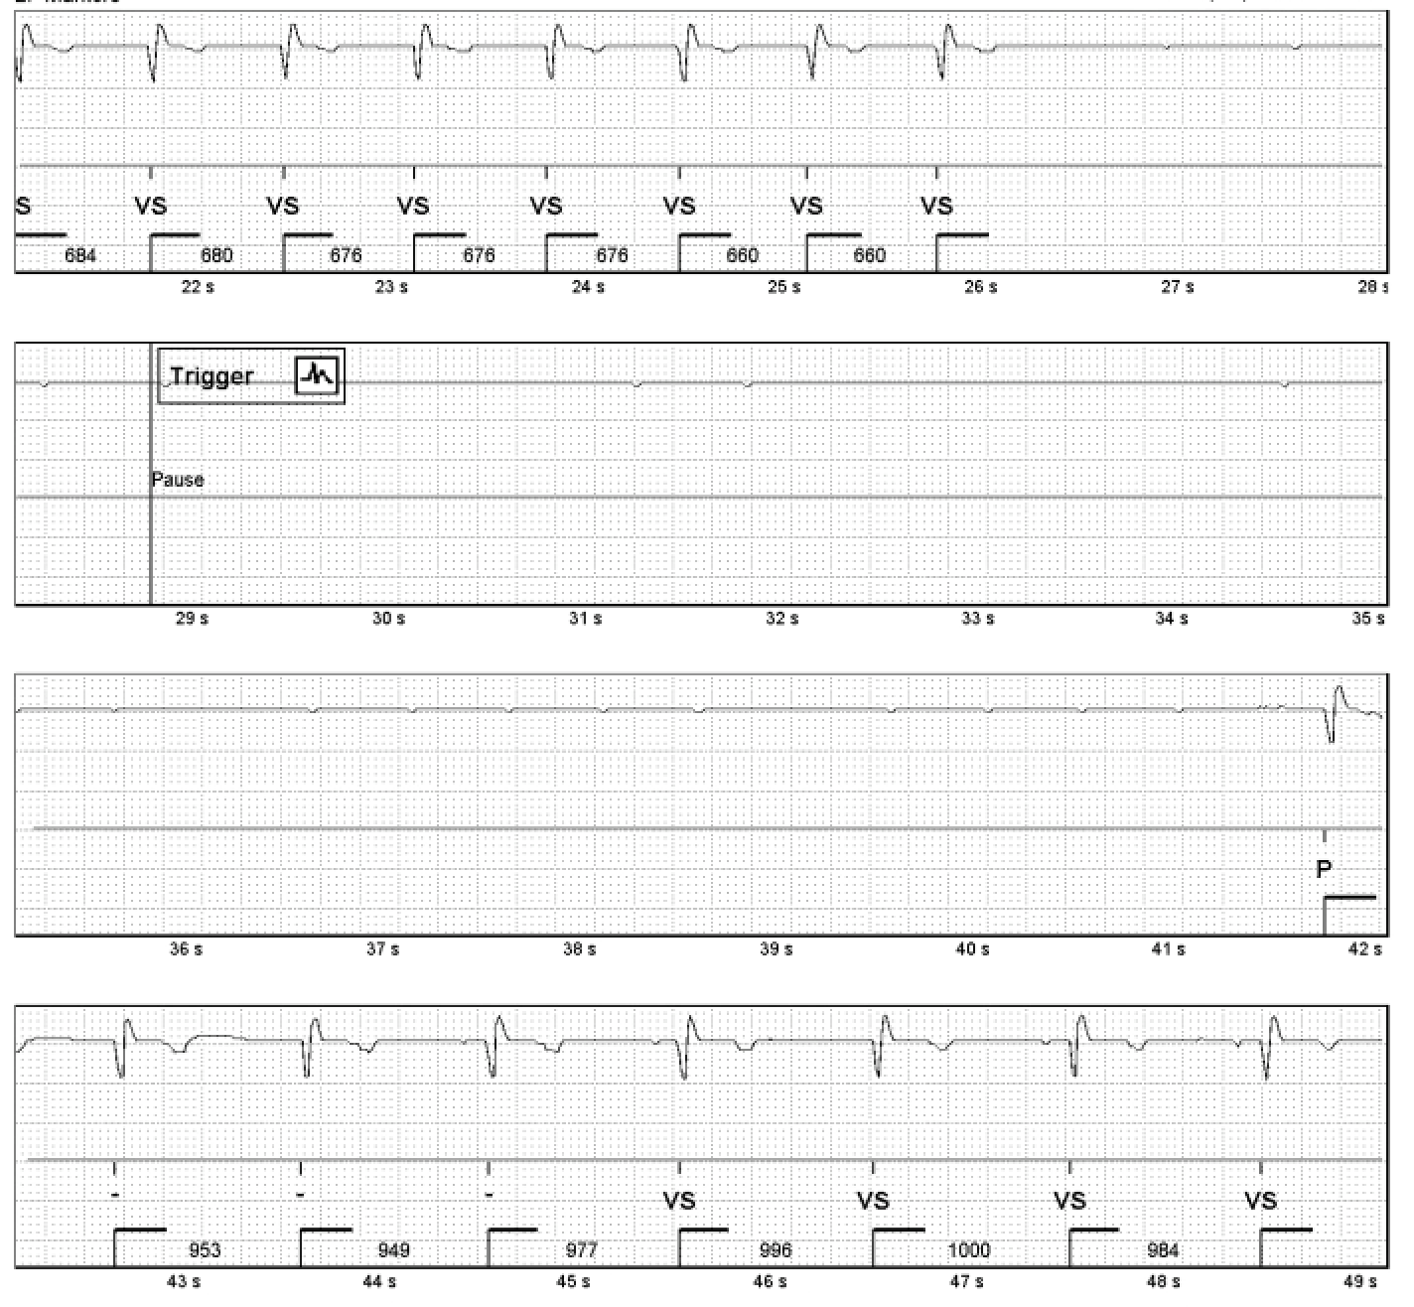
h
Case 1 (M/57)
Case 1 (M/57)
  2022년 5월 27일
  : ILR implanted
  2022년 6월 22일
  : Pause for 16 s
  2022년 6월 23일
  : Detection by RM
  (“약간 어지러웠던 것 같아요”)
  →당일
  admission & PM implantation

Slide 18
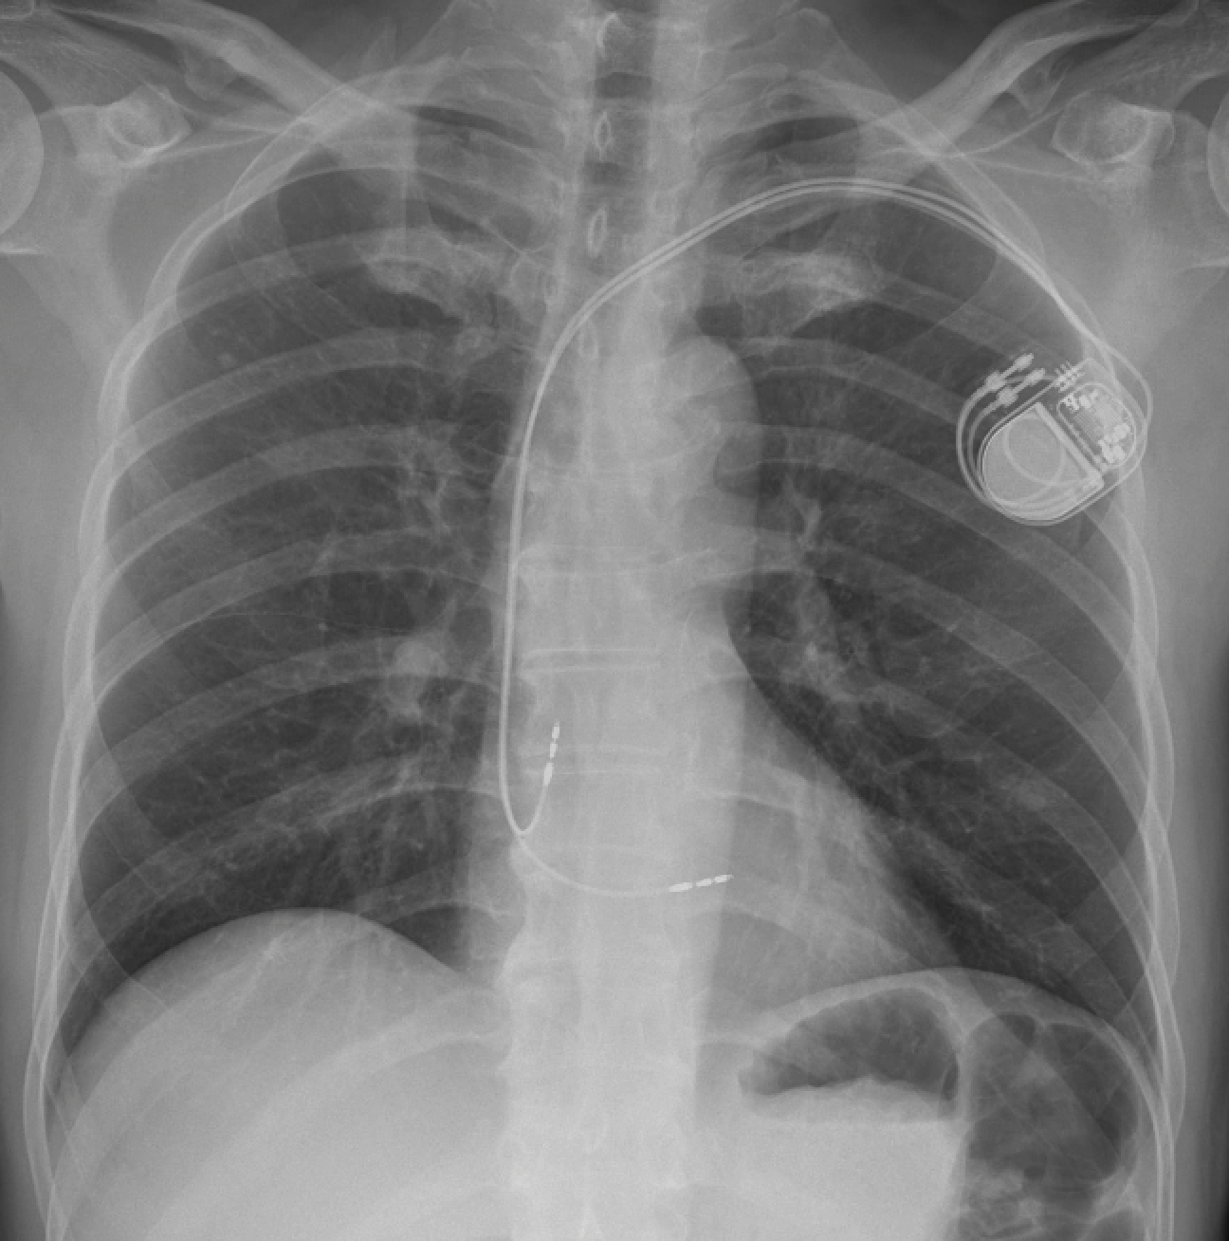
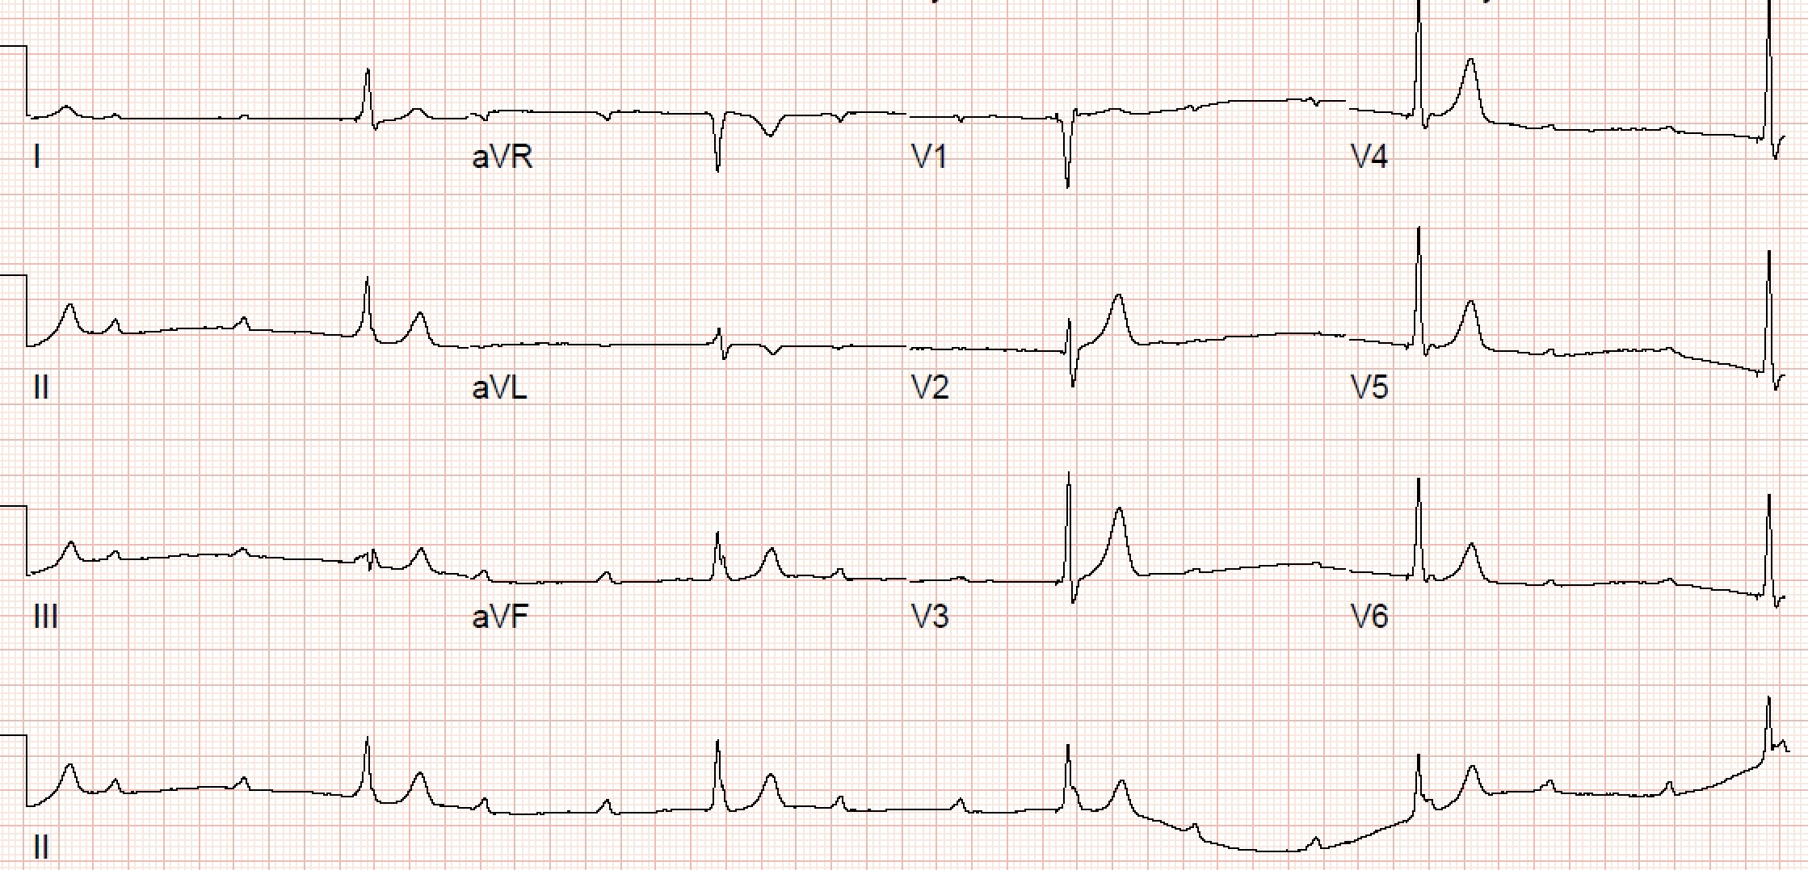
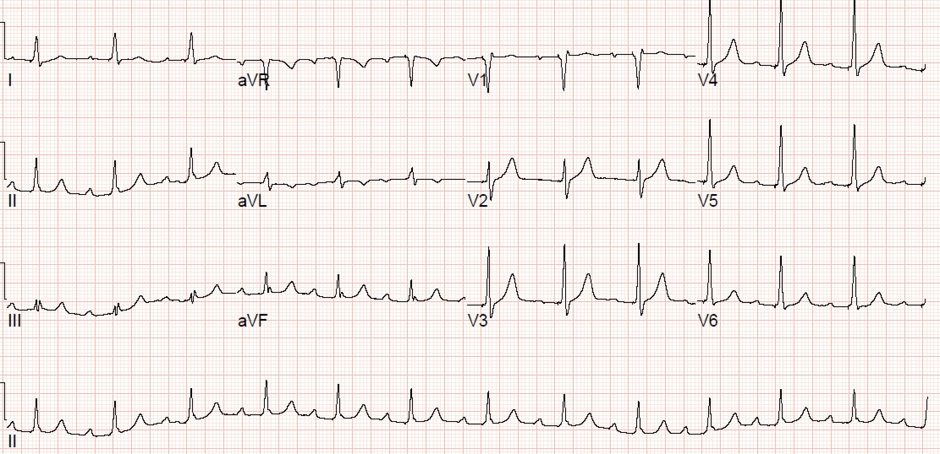
h
Case 1 (M/57)
Case 1 (M/57)
LBB area pacemaker implantation
→ No syncope for 6 months thereafter
& aggravated to PM dependent

Slide 19
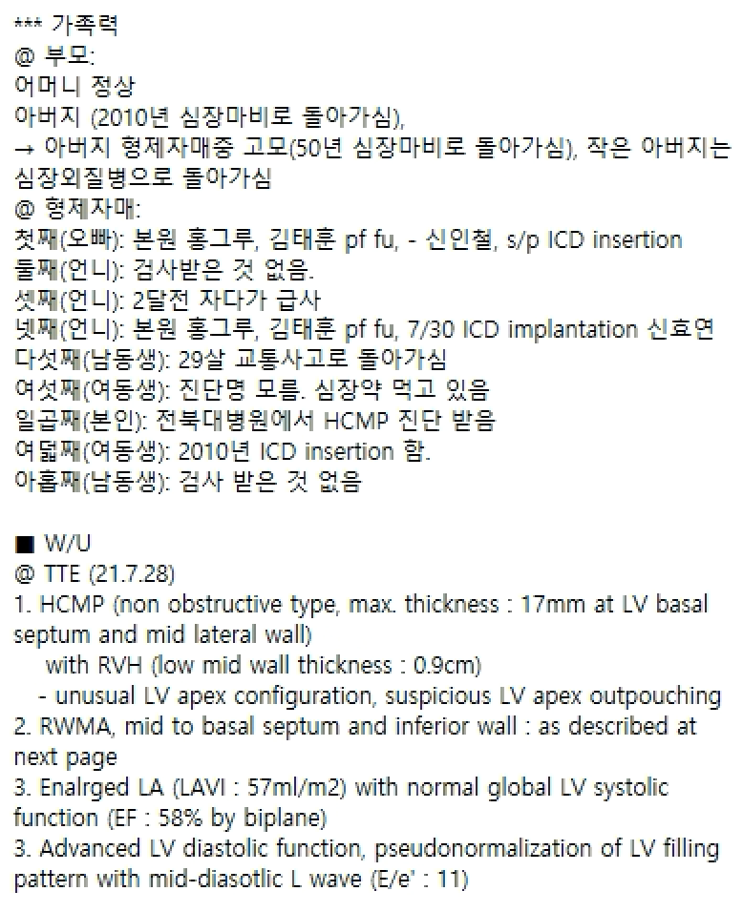
h
Case 1 (M/57)
Case 2 (F/51)
Non-obstructive HCM with strong family Hx of SCMP
s/p ICD implantation (2021.08.03)

Slide 20
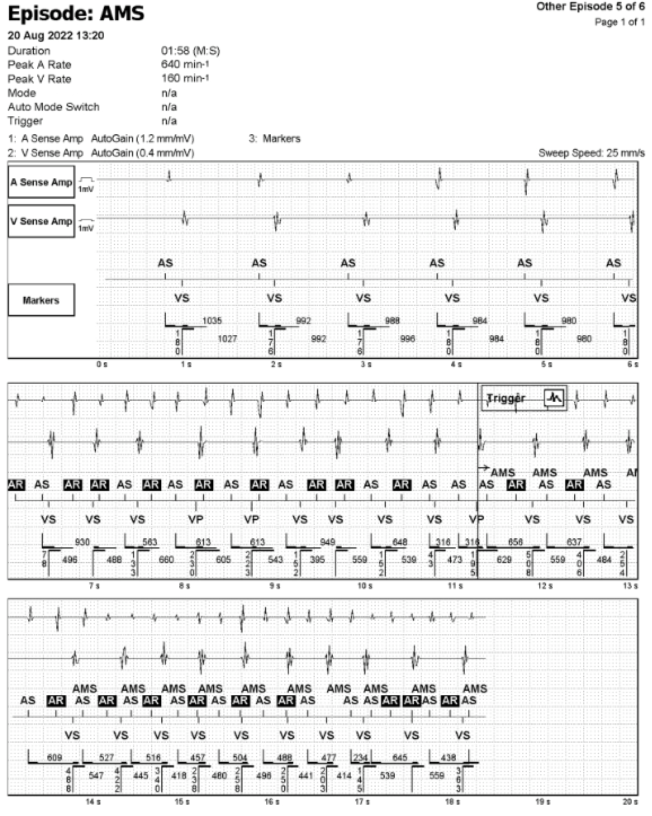
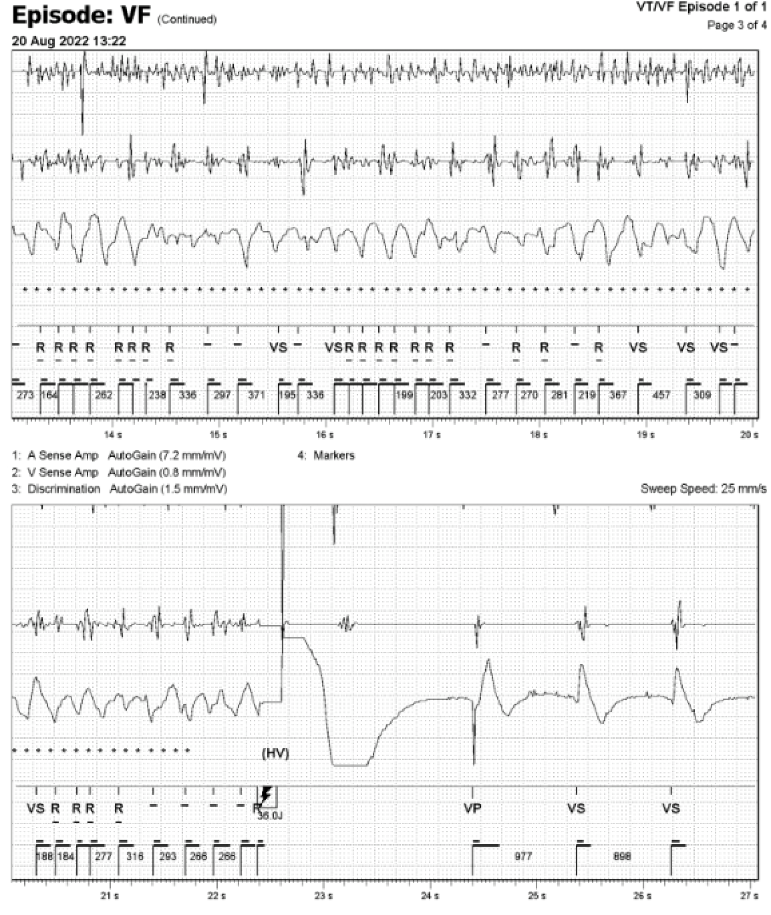
h
Case 1 (M/57)
Case 2 (F/51)
  2022년 8월 20일 First AHRE & Treated VF episode
  “점심 때 속이 좀 안 좋았고 버스를 기다리다가 식은땀이 나면서 쓰러졌다 깨어났어요”

Slide 21
h
Case 1 (M/57)
Case 2 (F/51)
  2022년 8월 20일 First AHRE & Treated VF episode
  2022년 8월 21일 Detection by RM
  2022년 8월 24일 OPD visit triggered by RM
  Edoxaban 30mg QD added
  Dronedarone 200mg BID added
  Bisoprolol 2.5mg -> 5mg QD up-titrated

Slide 22
Case 3 (M/65)
Case in courtesy of Rohit Mehta

Slide 23
Case 3 (M/65)
Medication
Metoprolol Succinate ER 100 BID
Sacubitril/Valsartan 49 mg-51 mg oral tablet BID
Spironolactone 25 mg QD
Furosemide 80 mg QD
Digoxin 250 mcg QD
Xarelto 20 mg QD
Atorvastatin 10 QD
HumaLOG
Rybelsus 7 mg QD
MetFORMIN 1000 mg BID
MethIMAzole 10 mg QD
Case in courtesy of Rohit Mehta

Slide 24
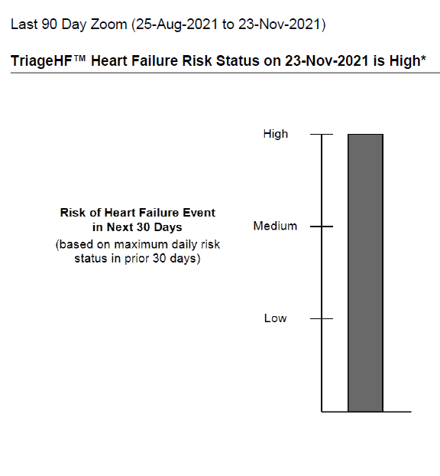
Case 3 (M/65)
Case in courtesy of Rohit Mehta

Slide 25
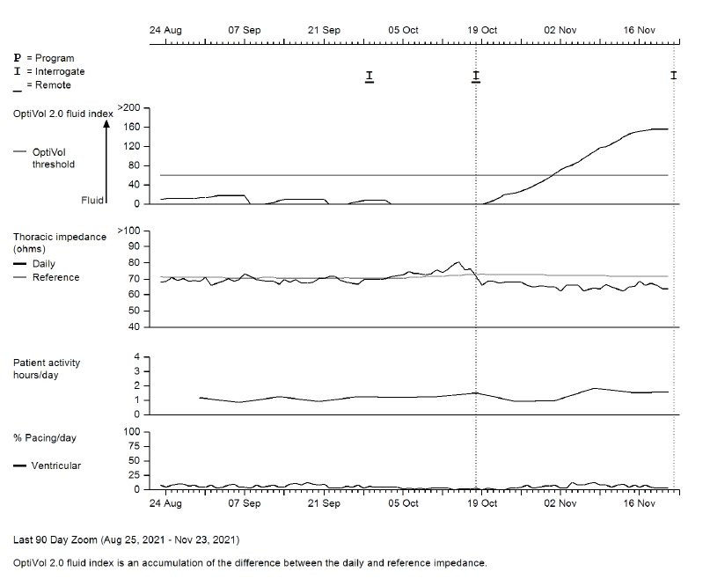
Case 3 (M/65)
Case in courtesy of Rohit Mehta

Slide 26
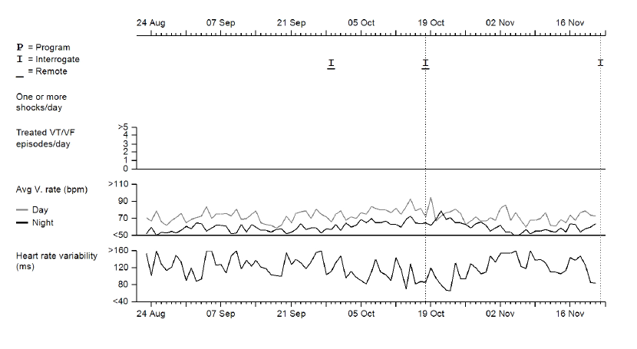
Case 3 (M/65)
Case in courtesy of Rohit Mehta

Slide 27
Case 3 (M/65)
Case in courtesy of Rohit Mehta

Slide 28
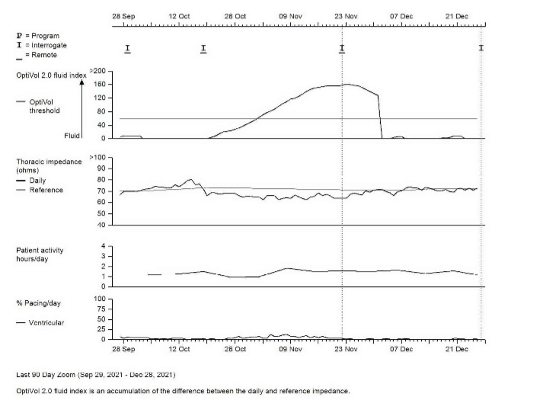
Case 3 (M/65)
During 5 weeks after intervention using TriageHF,
the patients was not admitted and dyspea on exertion was improved.
FU parameters
Case in courtesy of Rohit Mehta

Slide 29
Take Home Message
Remote device management includes
1. Remote follow-up with full remote device interrogation at scheduled intervals
(to replace in-office visits) (ongoing trial from 2020 in Korea)
2. Remote monitoring with unscheduled transmission of pre-defined alert events
3. Patient-initiated follow-up with unscheduled interrogations
as a result of a patient experiencing a real or perceived clinical event.
Recommended (Class I for PM and ICD)
to reduce the number of in-office follow-ups for PM (Class I)
In-office visits may be spaced 24 (PM) / 12 (CRT-P) months (Class IIa)
to enable early detection of actionable events in patients with recalled devices (Class I)
to provide earlier detection of clinical problems (e.g. arrhythmias)
or technical issues (e.g. lead failure or battery depletion) (Class IIa)
to reduce the incidence of inappropriate shocks (Class I)

Slide 30

Thank you for your attention!

